Slide 1
Optimization Methods
Sungjoon Choi

Slide 2
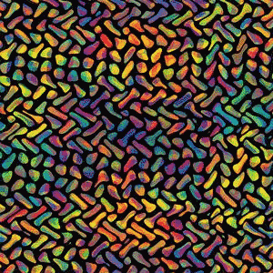
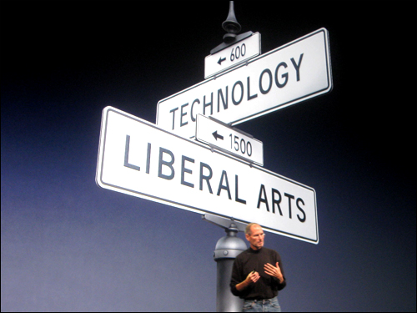
Optimization?

Slide 3
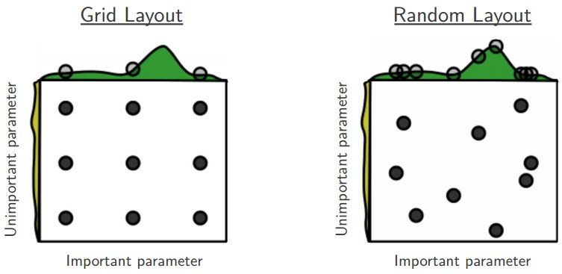
Random search?

Slide 4
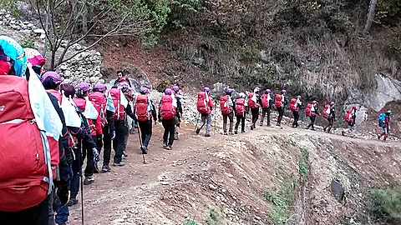
Gradient descent?

Slide 5
Gradient descent?
There are three variants of gradient descent
Differ in how much data we use to compute gradient
We make a trade-off between the accuracy and computing time

Slide 6
Batch gradient descent
In batch gradient decent, we use the entire training dataset to compute the gradient.

Slide 7
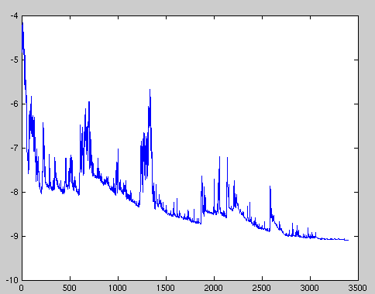
Stochastic gradient descent
In stochastic gradient descent (SGD), the gradient is computed from each training sample, one by one.

Slide 8

Mini-batch gradient decent
In mini-batch gradient decent, we take the best of both worlds.
Common mini-batch sizes range between 50 and 256 (but can vary).

Slide 9
Challenges
Choosing a proper learning rate is cumbersome.
→ Learning rate schedule
Avoiding getting trapped in suboptimal local minima

Slide 10
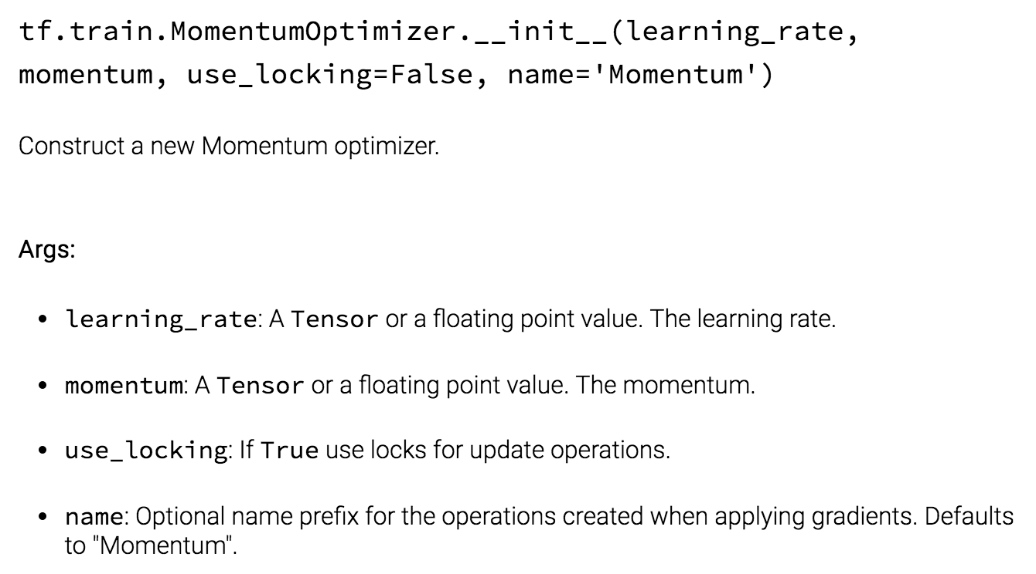
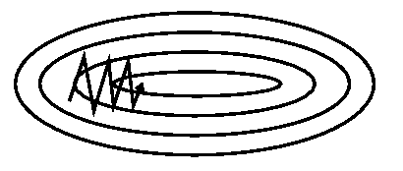
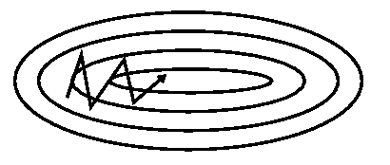
Momentum

Slide 11
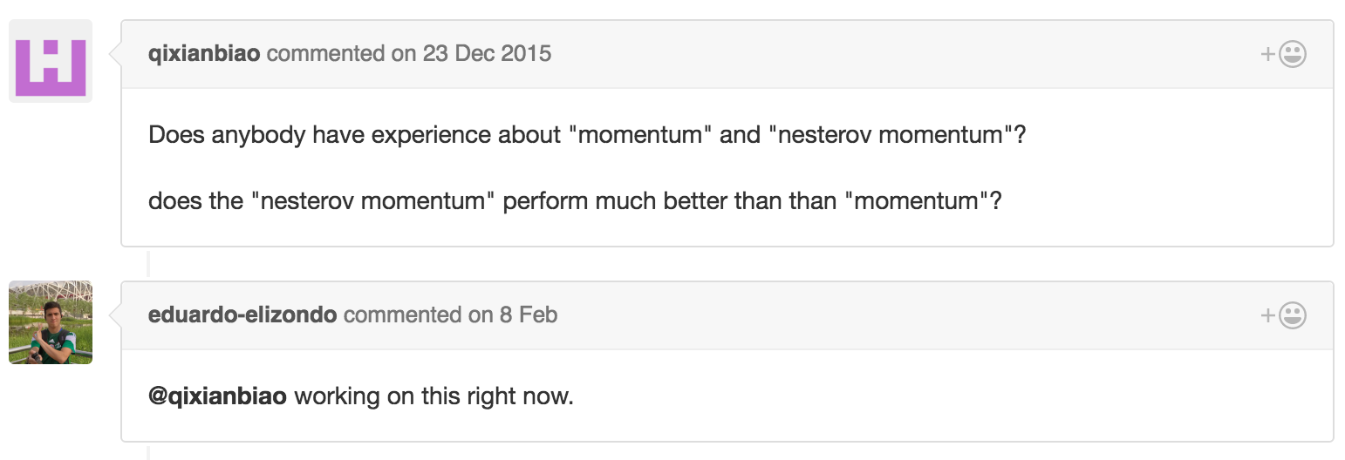
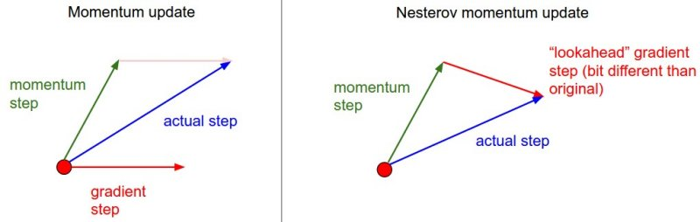
Nesterov accelerated gradient

Slide 12
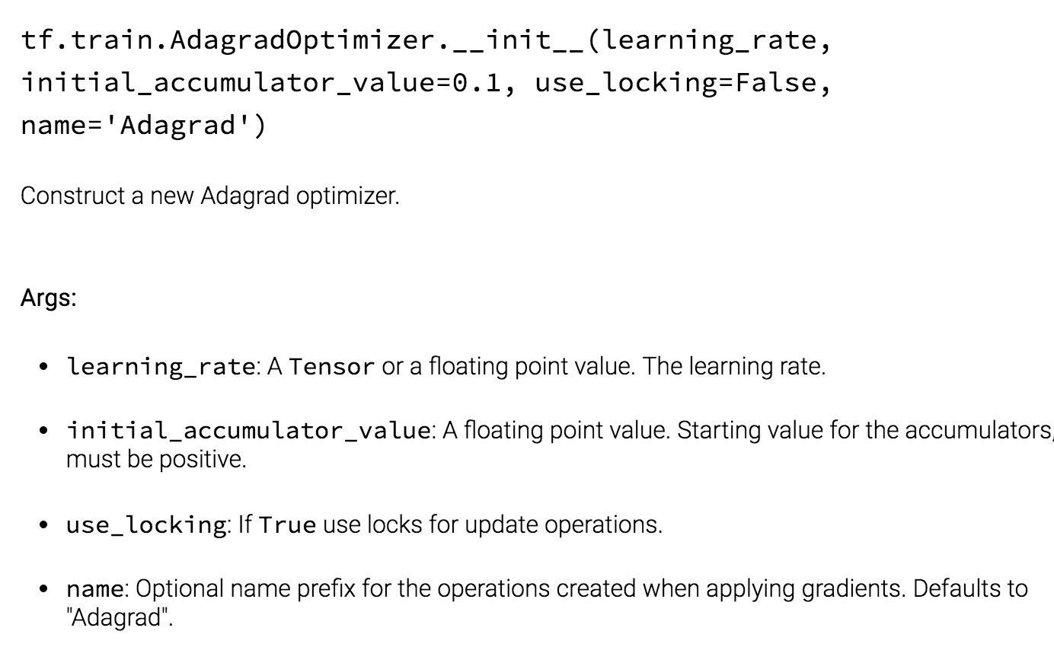
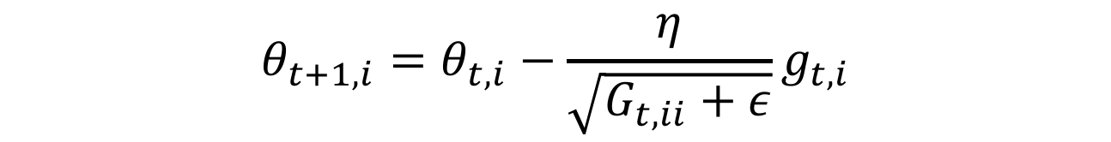
Adagrad
It adapts the learning rate to the parameters, performing larger updates for infrequent and smaller updates for frequent parameters.
$$θ_{t+1, i}=θ_{t, i}−\frac{η}{\sqrt{G_{t, ii}+ε}}g_{t, i}$$
Performing larger updates for infrequent and smaller updates for frequent parameters.

Slide 13
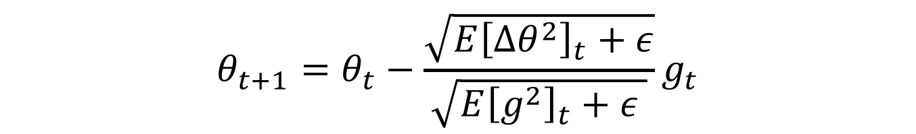
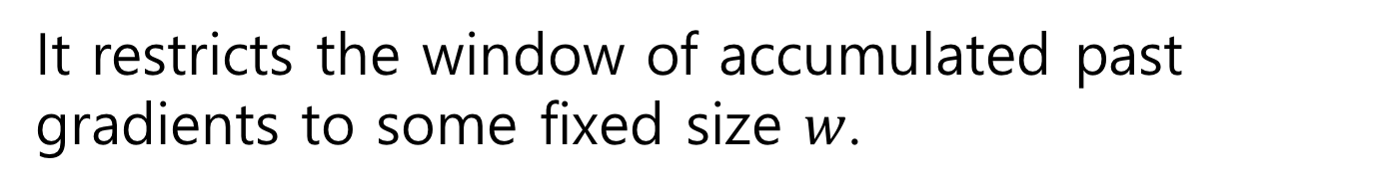
Adadelta
Adadelta is an extension of Adagrad that seeks to reduce its monotonically decreasing learning rate.
It restricts the window of accumulated past gradients to some fixed size $w$.
$$E{\left[g^{2}\right]}_{t}=γE{\left[g^{2}\right]}_{t−1}+\left(1−γ\right)g_{t}^{2}$$
$$E{\left[∆θ^{2}\right]}_{t}=γE{\left[∆θ^{2}\right]}_{t−1}+\left(1−γ\right)∆θ_{t}^{2}$$
$$θ_{t+1}=θ_{t}−\frac{\sqrt{E{\left[∆θ^{2}\right]}_{t}+ε}}{\sqrt{E{\left[g^{2}\right]}_{t}+ε }}g_{t}$$

Slide 14
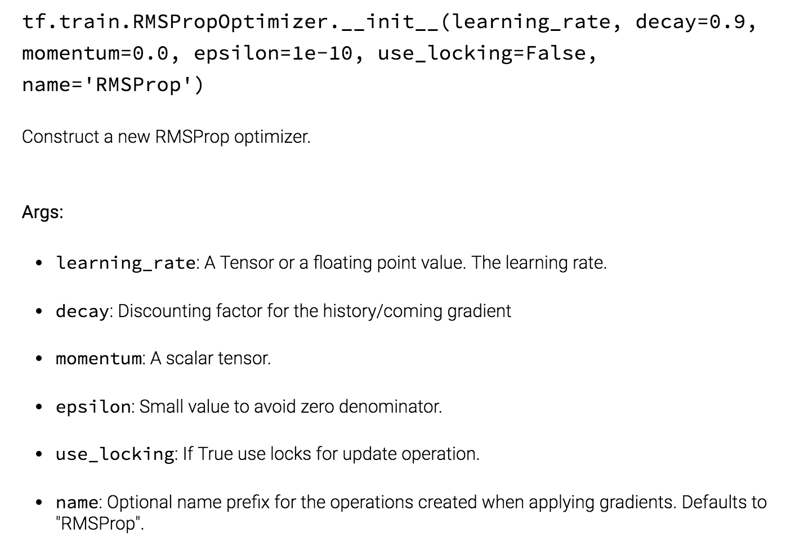
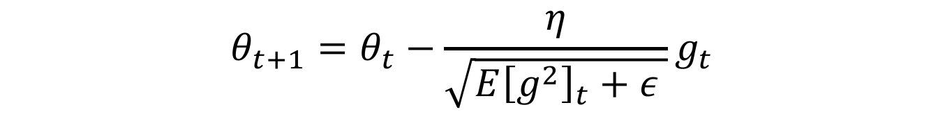
RMSprop
RMSprop is an unpublished, adaptive learning rate method proposed by Geoff Hinton in his lecture..
$$E{\left[g^{2}\right]}_{t}=γE{\left[g^{2}\right]}_{t−1}+\left(1−γ\right)g_{t}^{2}$$
$$θ_{t+1}=θ_{t}−\frac{η}{\sqrt{E{\left[g^{2}\right]}_{t}+ε }}g_{t}$$

Slide 15
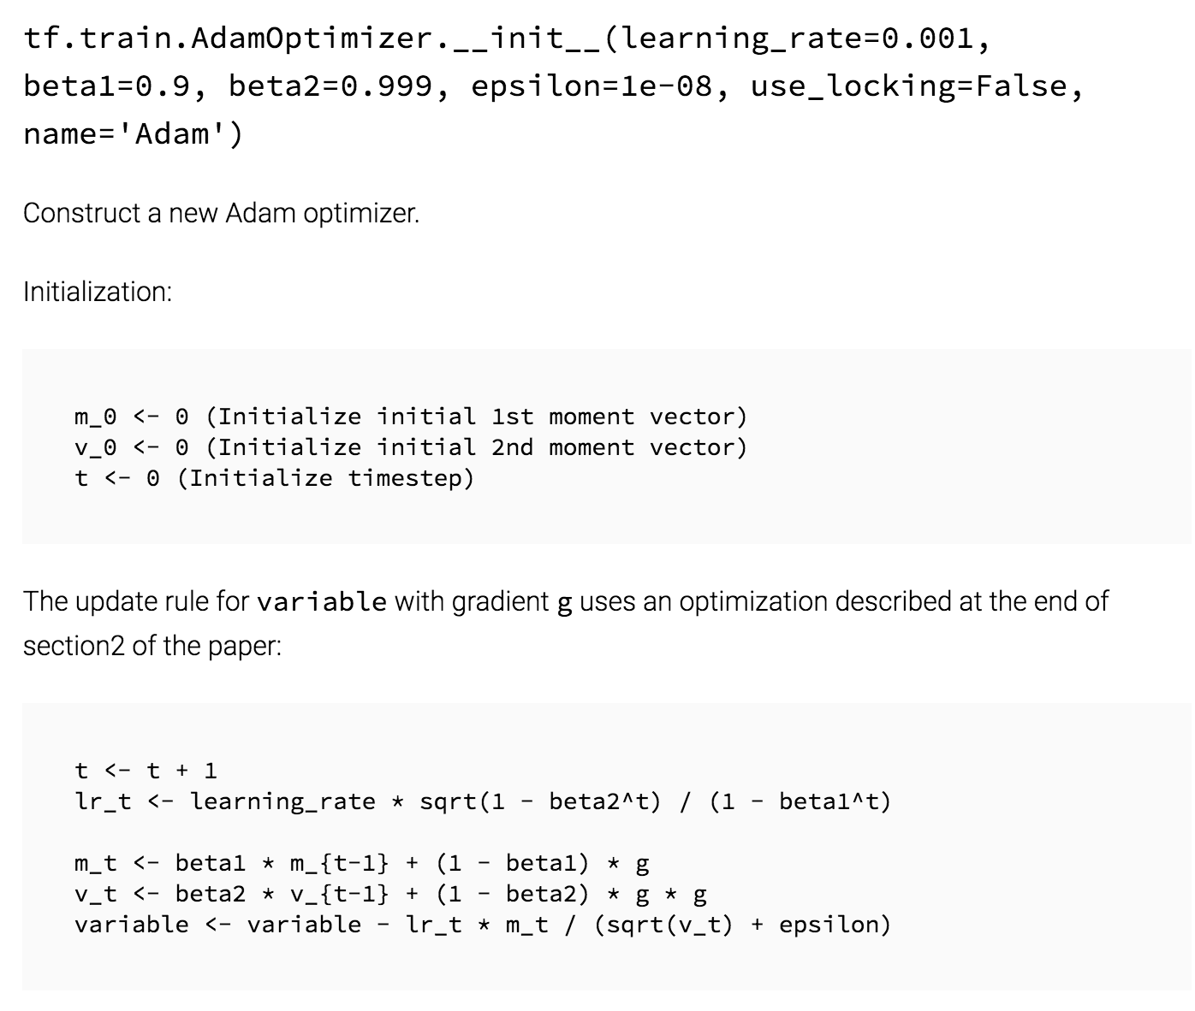
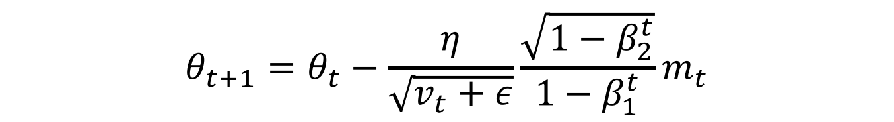
Adam
Adaptive Moment Estimation (Adam) stores both exponentially decaying average of past gradients and and squared gradients.
$$m_{t}=β_{1}m_{t−1}+\left(1−β_{1}\right)g_{t}$$
$$v_{t}=β_{2}v_{t−1}+\left(1−β_{2}\right)g_{t}^{2}$$
$$θ_{t+1}=θ_{t}−\frac{η}{\sqrt{v_{t}+ε}}{\frac{\sqrt{1−β_{2}^{t}}}{1−β_{1}^{t}}m}_{t}$$

Slide 16


Visualization

Slide 17
Which optimizer to use?
Use adaptive learning rate methods (Adagrad, Adadelta, RMSprop, Adam)
Adagrad decreases the learning rate of more activated features.
RMSprop extends Adagrad by dealing with radically diminishing learning rates (=Adadelta).
Adam adds bias-correction and momentum to RMSprop.

Slide 18
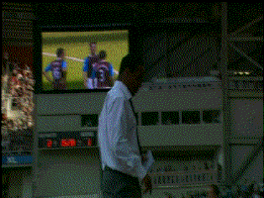
Additional strategies

Slide 19
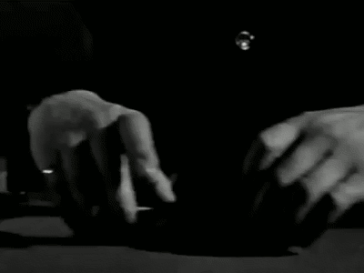

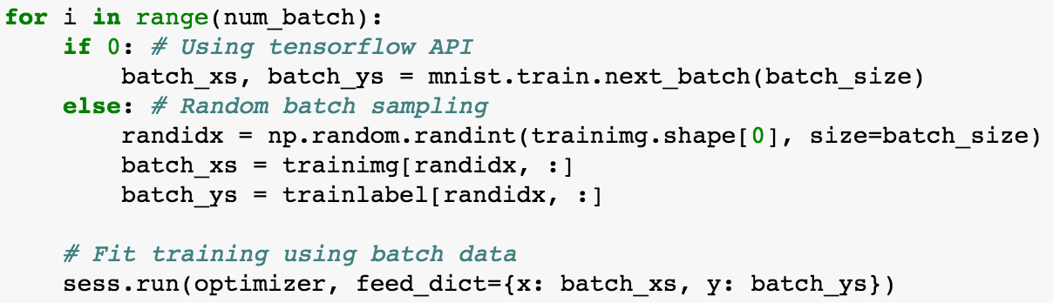
Shuffling

Slide 20
Curriculum Learning

Slide 21
Batch normalization

Slide 22
Early stopping

Slide 23

Gradient noise

Slide 24

Learning rate

